Slide 1
Business Continuity
Training
Updated January 2021

Slide 2
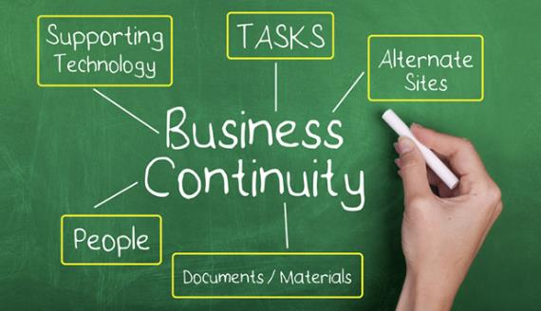
Introduction & Objectives
Learn about Business Continuity
Understand the planning process
Be able to complete department plan

Slide 3

Business Continuity
… Is:
a process to minimize the impact of a major disruption to normal operations
a process to enable restoration of critical assets
a process to restore normalcy as soon as possible after a crisis.
… Is not just:
recovery of information technology resources

Slide 4

Business Continuity
… a “disaster”
is an event, often unexpected, that seriously disrupts your usual operations or processes and can have long term impact on your normal way of life or that of your organization.

Slide 5
Business Continuity
Incident Phases
Normal Ops
Incident Response
Business Continuity
… and it is the phase of crisis management that follows the immediate actions taken to protect life and property and contain the event
… it begins when the situation has been stabilized.
Recovery/Return to Normal

Slide 6
Why Develop a Plan
The Risk Matrix
PROBABILITY
LOW
HIGH
LOW
NORMAL
PROCEDURES
IGNORE
IMPACT
CHANGE
SOMETHING
Change
HIGH
PLAN

Slide 7
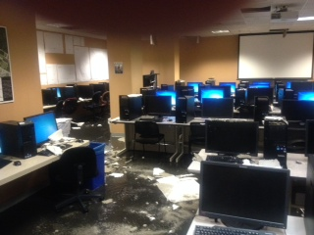
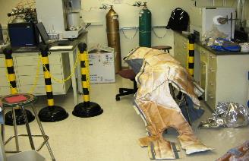
“Yeah…but will it ever happen here?"
“Fire in Notre Dame utility
tunnel extinguished”
Building Fire
Flood
IT Malfunction
Tornado / Severe Weather
Pandemic
Other Reasons…
Bond Hall computer lab flood damage
Nieuwland Hall lab flood damage
“Power outages affect 20 buildings on campus”
Observer Staff Report | September 2, 2020

Slide 8




Purpose of Department Planning
University’s Overall Plan
Key Leadership Succession
Orderly Incident Response
Minimze Damage & Losses
Continue Essential Operations

Slide 9

Department Responsibilities
Develop & approve your department plan
Train staff on your plan
Gain proficiency in implementing your plan by conducting tests, training and exercises
Review training/testing outcomes and update the plan

Slide 10
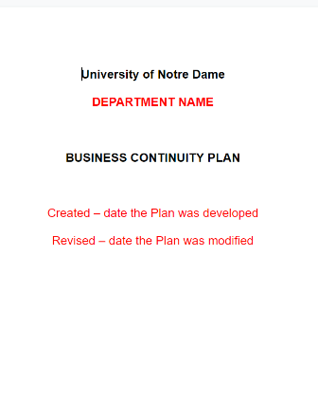
Building your Plan
Plan Template
Preamble / Purpose
Scope
Definitions
List of essential functions
Continuity of Operations
Outsource Options (If applicable)
Annual Plan Review and Testing

Slide 11

Purpose & Scope
Purpose: Outline the reason for developing a plan
Scope:
Describe what this plan covers and how it supports the University’s primary mission of teaching and research.
Include a description of the operations covered by the plan.

Slide 12
Identify Essential Functions
What critical tasks do we perform???
Identify:
Functions/tasks
People
Who performs these tasks (job classes, number of people, etc)
3. Infrastructure Needs
buildings & space, equipment, vehicles
4. IT requirements
Examples: internet connection, specific programs, phone, etc.
What do we require to do them???

Slide 13
Design Your Response
What will you do if normal operations are disrupted?
Response
Communicate
Essential Financial Processes
Critical Suppliers
Workarounds

Slide 14


Designing Your Response
What will you do if normal operations are disrupted
Communicate: How will you inform staff & stakeholders?
Identify workarounds:
Identify essential financial processes
Develop list of critical suppliers
Staff
Suppliers
Internal
Stakeholders
External
Stakeholders

Slide 15
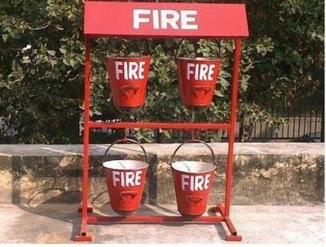
Designing Your Response
What will you do if normal operations are disrupted
Communicate: How will you inform staff & stakeholders?
Identify workarounds:
  How do you replace lost infrastructure
  Is there a loss/decrease level of service
  Can the task be outsourced
Identify essential financial processes
Develop list of critical suppliers – who do you contact, what can they provide, is there an open purchase order

Slide 16

Designing Your Response
What will you do if normal operations are disrupted
Communicate: How will you inform staff & stakeholders?
Identify workarounds:
  How do you replace lost infrastructure
  Is there a loss/decrease level of service
  Can the task be outsourced
Identify essential financial processes
Develop list of critical suppliers – who do you contact, what can they provide, is there an open purchase order

Slide 17

Designing Your Response
What will you do if normal operations are disrupted
Communicate: How will you inform staff & stakeholders?
Identify workarounds:
  How do you replace lost infrastructure
  Is there a loss/decrease level of service
  Can the task be outsourced
Identify essential financial processes
Develop list of critical suppliers –
  Who do you contact
  What can they provide
  Is there an open purchase order

Slide 18

Vital Records and Databases
Identify vital records (hard copy & electronic)
Plan for protection, duplication and movement of records
Ensure back-up of legal and financial records

Slide 19
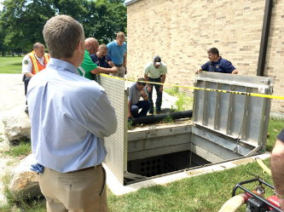
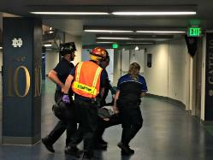
Testing, Training and Exercises
Conduct orientation and training
Periodically test alert and notification procedures
Plan periodic exercise of operational plans, alternate facilities, and interoperable communications
Establish process to address correct deficiencies
Keep plans updated

Slide 20

Next Steps
Develop a written plan
Provide copies to all employees with roles
Establish training and exercise schedule
Maintain and update

Slide 21

Please call RMS at 574-631-5037
or
Emergency Management at 574-631-8344

